Slide 1
Summary Writing
Definition
Characteristics
Prewriting
Writing
Postwriting

Slide 2

Summary Writing
A summary, is an abridgement expressing the main ideas of a text passage through reported speech. A successful summary is not an exhibition of the writer's own opinions, but a refinement of the essential points in an original text.
In summary writing, three points should be emphasized:
summaries are shorter than original texts,
they contain the main ideas of a text, and
they are in reported speech.

Slide 3

Characteristics of a Good Summary
Brief
Complete
Paraphrased
Objective

Slide 4
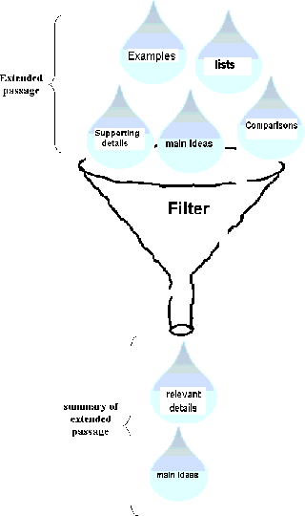
Good Summary?!
Writing a good summary demonstrates that you clearly understand a text and that you can make your readers understand what you are trying to say. A summary can be tough to write at first as you might include too much or too little information.
Summary writing is essential if reading comprehension needs to be checked. A text comprises of lots of details ranging from majors to minor. If students are able to identify, point out and paraphrase those points, then it would show their successful understanding of the text.

Slide 5
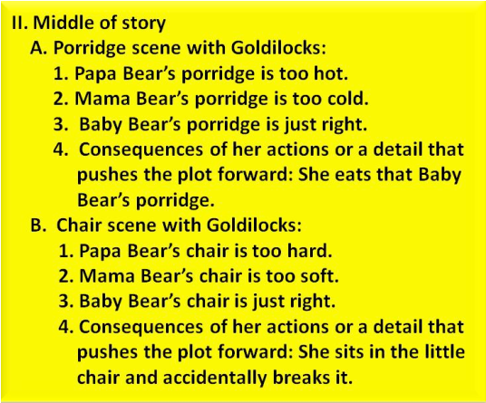
Steps in Writing a Summary: Prewriting
BREAK DOWN & DIGEST
First, skim through the text you are required to summarize and divide it into sections. Understand the contents properly. Be sure to focus on any headings and subheadings. Also, you should take note of terms in bold and make sure you understand them before you read.
Annotate the article, noting the thesis statement and the major supporting details
Using your notes, create an outline that shows the main organization of the article.

Slide 6
Steps in Writing a Summary: Re-reading
Go back and re-read the areas you identified as most important.
Rereading should be active reading. Make sure that you underline topic sentences and key facts. Label areas that you want to refer to as you write your summary. Also, label areas that should be avoided because the details — although they may be interesting — are too specific or unrelated. Identify areas that you do not understand and try to clarify those points.
Take notes to get the main idea and key points by asking these questions.
Who is this about?
What is it about?
When is it happening?
Where is it happening?

Slide 7
Steps in Writing a Summary: Writing
WRITE A TITLE
ONE SENTENCE AT A TIME
You should now have a firm grasp on the text that you will be summarizing. In the previous steps, you have divided the selection into sections and located the author’s main ideas and points. Now, write down the main idea of each section in one well-developed sentence. Make sure that what you include in your sentences are key points, not minor details.
WRITE A THESIS STATEMENT [HYPOTHESIS]
This is the key to any well-written summary. Review the sentences that you wrote in the previous step. From the sentences, you should be able to create a thesis statement that clearly communicates what the entire text was trying to achieve. If you find that you are unable to do this step, then you should return to the previous step and make sure your sentences actually addressed key points.

Slide 8

Steps in Writing a Summary: Writing
Begin with a sentence that includes
author’s/website’s name
title of the article
thesis of the article
According to Joe Smith in “Pets Are an Important Part of a Healthy Lifestyle,” choosing to have a pet influences the length and quality of our lives.
Joe Smith states in “Pets Are an Important Part of a Healthy Lifestyle” that our pets influence the length and quality of our lives.

Slide 9

Steps in Writing a Summary: Writing
Follow with sentences that paraphrase major supporting points
(When you paraphrase, you have use your own words.)
Enclose any directly quoted material in quotation marks
Write a one or two-sentence account of each section you identify. Focus your attention on the main point. Leave out any illustrative examples.
After the first sentence, refer to the author by last name or as “the author”
(Smith points out that, “pets increase longevity.”)

Slide 10
Writing Tips
READY TO WRITE
At this point, your first draft is done. You can use the thesis statement as the introductory sentence of your summary, and your other sentences can make up the body. Make sure that they are in order. Add some transition words (for example: then, however, also, moreover) that help with the overall structure and flow of the summary. Once you start writing, take note of these points…(Continued on the next slide)

Slide 11
Writing tips
SOME POINTERS
→Write in the present or past tense, depending on the context of the question (i.e., how the question is phrased) and what tense the first few words that are given to help you begin are in.
→Make sure to include the author and title of the work.
→Be concise: a summary should not be equal in length to the original text.
→If you must use the words of the author, cite them. Otherwise, USE YOUR OWN WORDS (for example, instead of “in actual fact”, write “actually”)!
→Do not add in your own opinions, ideas, or interpretations into the summary. The purpose of writing a summary is to accurately represent what the author wanted to say, not to provide a critique.

Slide 12
How to Condense a Summary
Omit examples
Omit restatements
Create lists to combine key points from multiple sentences or paragraphs

Slide 13
Steps in Writing a Summary: Revising
CHECK FOR ACCURACY
Reread your summary and make sure that you have accurately represented the author’s ideas and key points. Be sure that you have correctly cited anything directly quoted from the text. Also, check to make sure that your text does not contain your own commentary on the selection.

Slide 14

Steps in Writing a Summary: Revising
Compare the summary to the original article to make sure you have included all the important points.
Double check to make sure you have paraphrased the material accurately.
Once you are certain that your summary is accurate, you should (as with any piece of writing) revise it for style, grammar, and punctuation. You should be able to understand the main text based on your summary alone. If you do not, you may have focused too much on one area of the piece and not enough on the author’s main idea.

